Slide 1


Slide 2
BellevueJS
@jdalton

Slide 3

lodash.com
I created

Slide 4

Like

Slide 5
Most depended upon
lodash - 14,148
async - 11,085
request - 10,318
underscore - 10,220

Slide 6
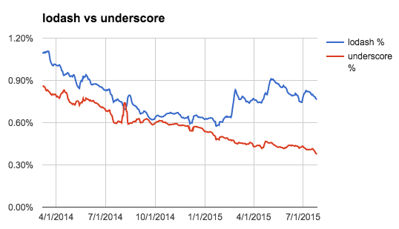

Slide 7
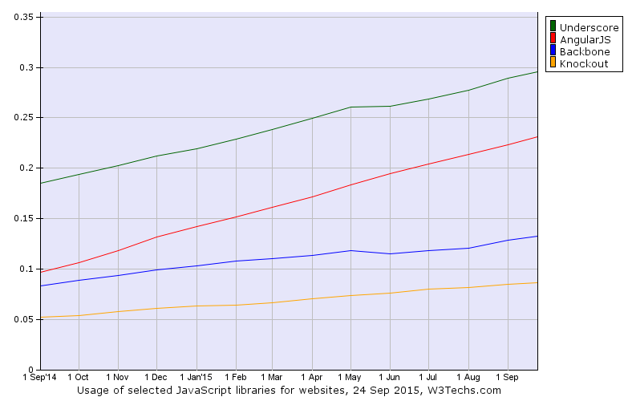

Slide 8
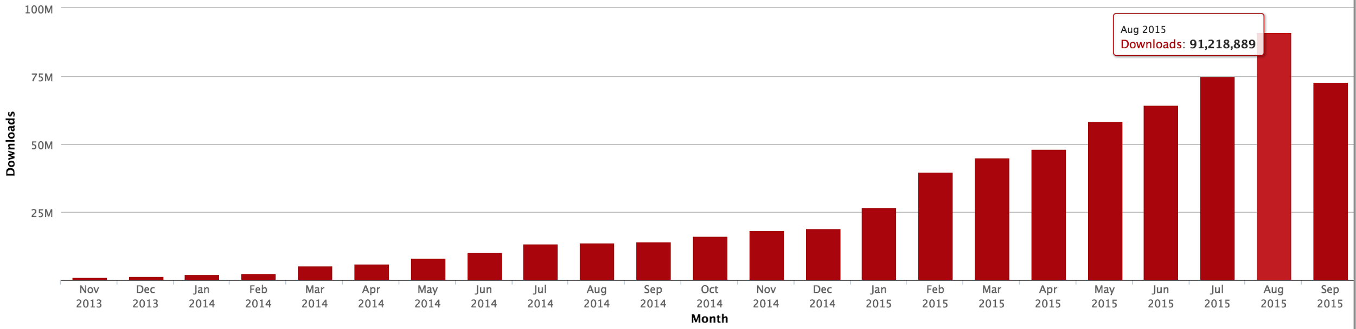
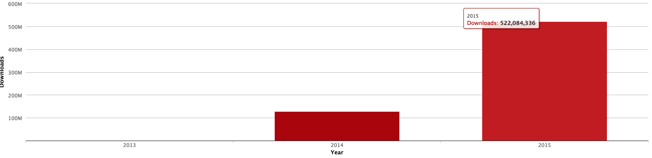
Downloads

Slide 9
3-5% of npm’s daily download traffic
Downloads

Slide 10
50+ a second
3,000+ a minute ~200,000 an hour
Downloads

Slide 11
How did I do it?

Slide 12
Happy accident

Slide 13
Meet devs where they are

Slide 14
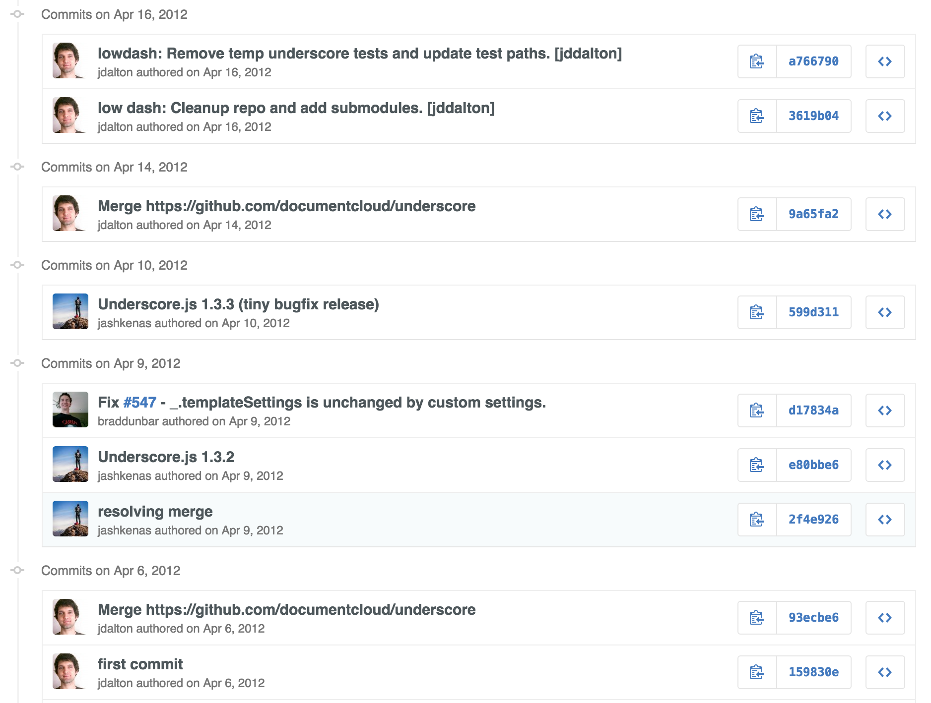

Slide 15
Push quality

Slide 16
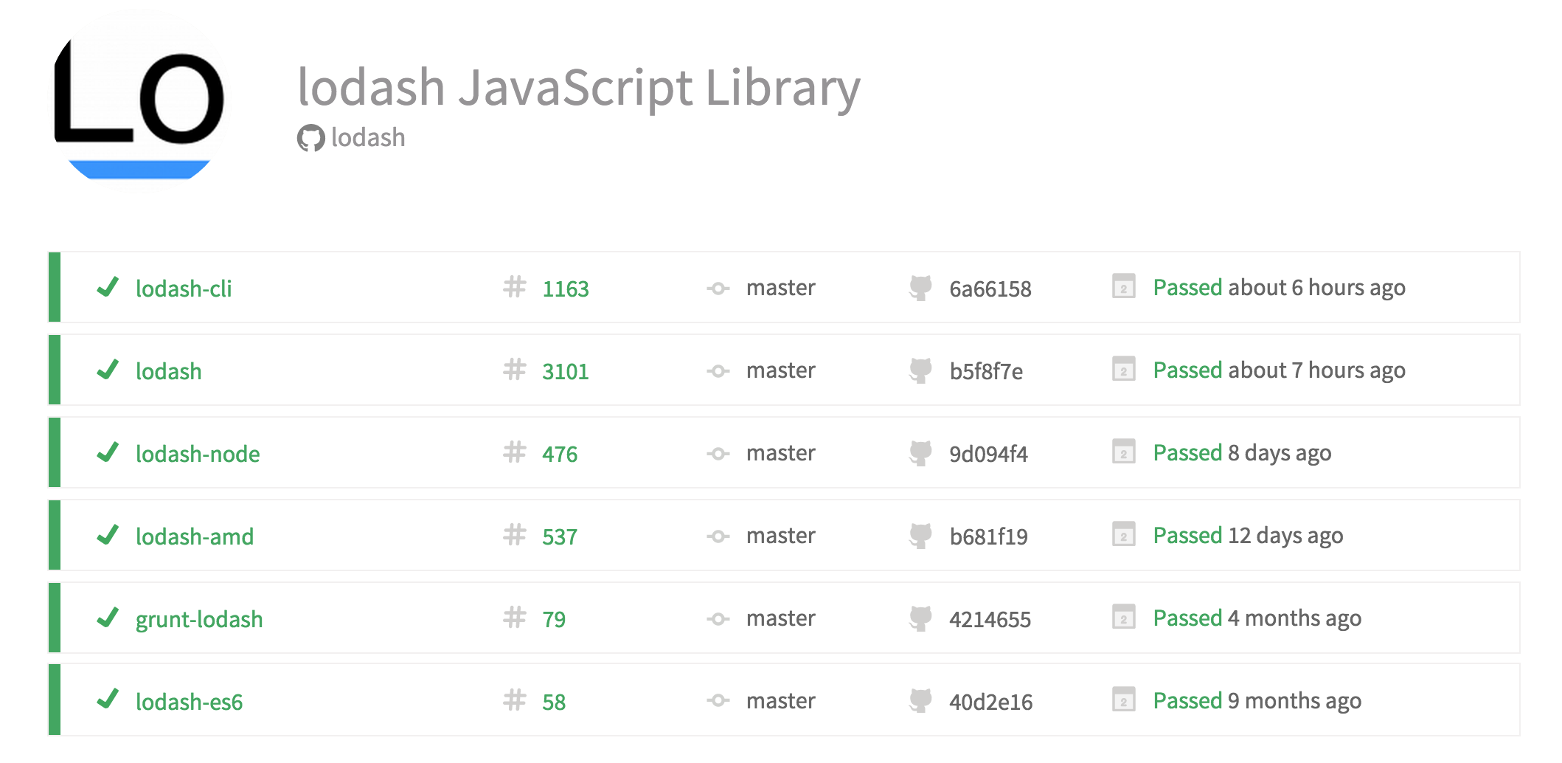

Slide 17
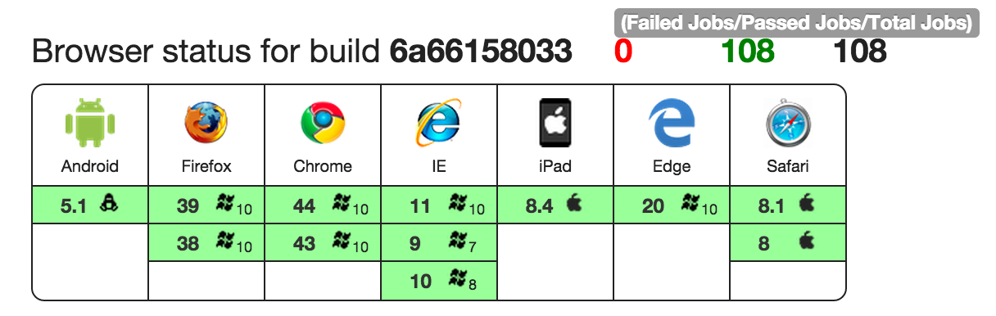

Slide 18
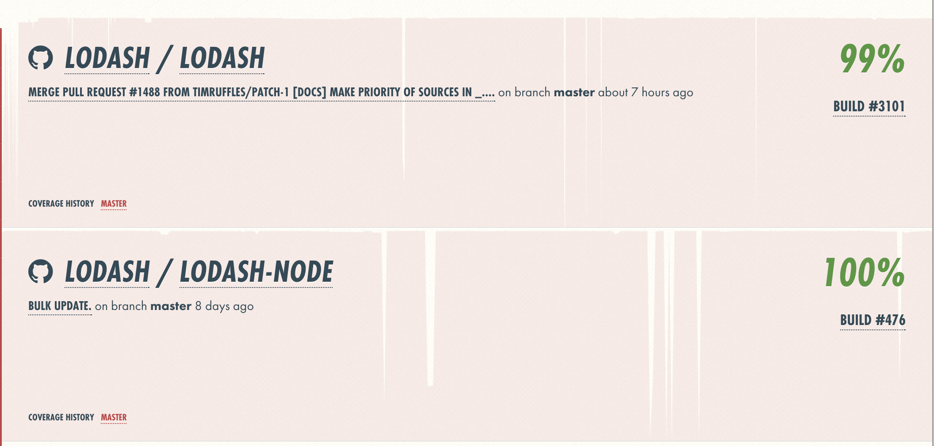

Slide 19
Documentation

Slide 20
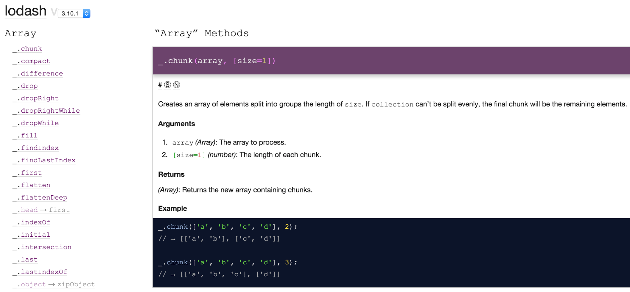

Slide 21
Roadmap

Slide 22
Continuous contributions

Slide 23
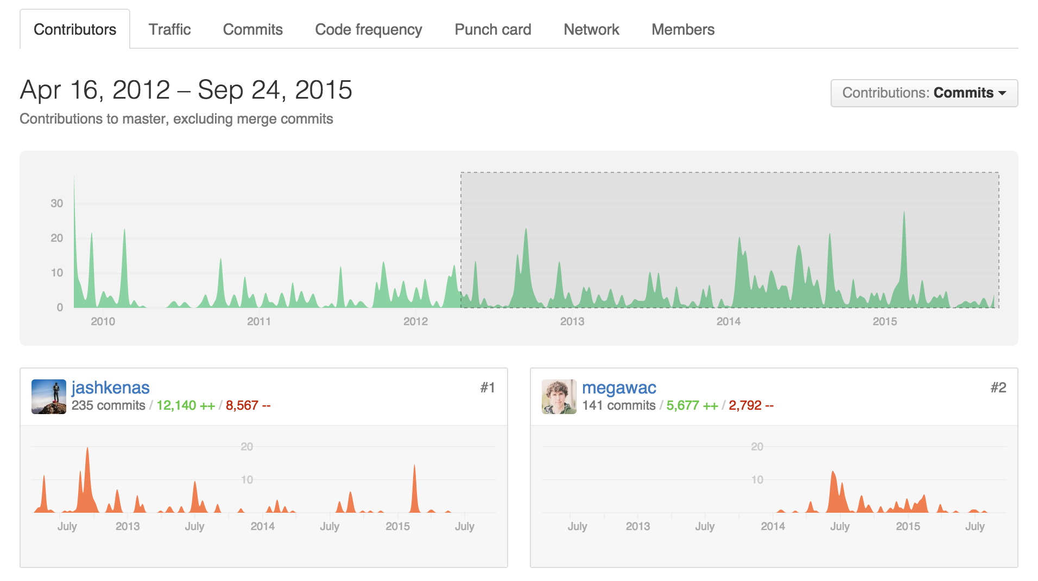
Continuous contributions

Slide 24
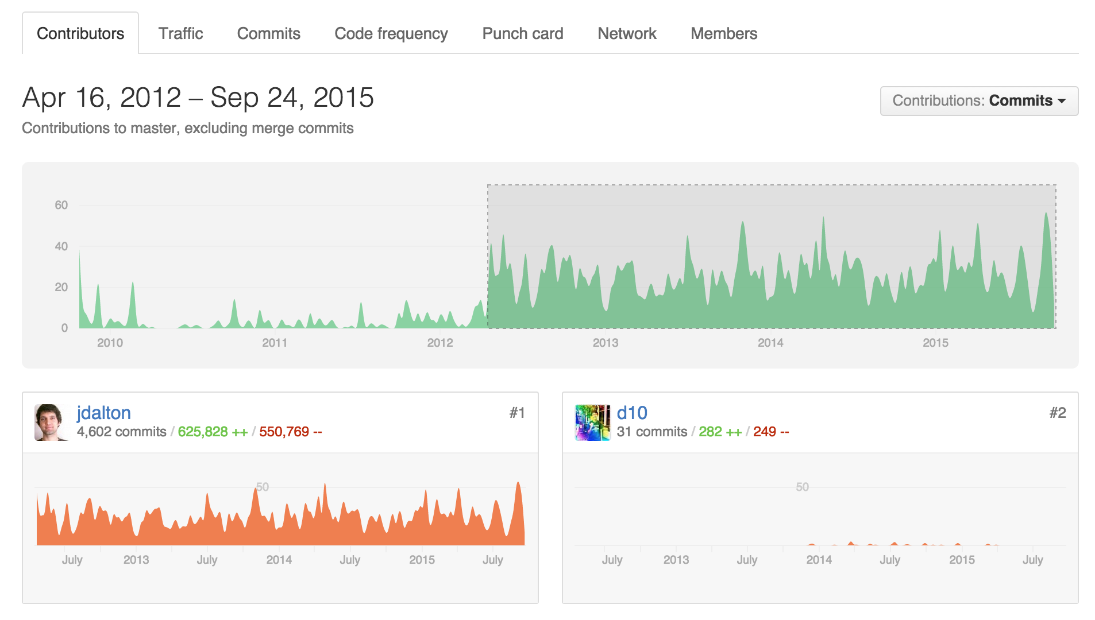
Continuous contributions

Slide 25
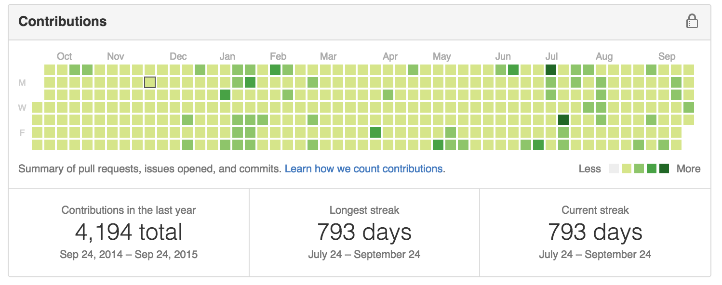

Slide 26
Get Help

Slide 27
Strong opinions

Slide 28
Big tent

Slide 29
Say NO

Slide 30


Slide 31
Learn from your competitors

Slide 32
Evolve

Slide 33
Remove roadblocks

Slide 34
Encourage

Slide 37
END!

